Slide 1
Welcome to Calvary!

Slide 2
Reformation Stewardship Series …What Martin Luther says about:
Service – October 1 & 4
Family – October 8 & 11
Citizenship – October 15, 18
Being a Neighbor – Oct. 22 & 25
Hearer/Confessor – Reformation Oct. 30 & Nov. 1
Family Friendly Activities/Services

Slide 3
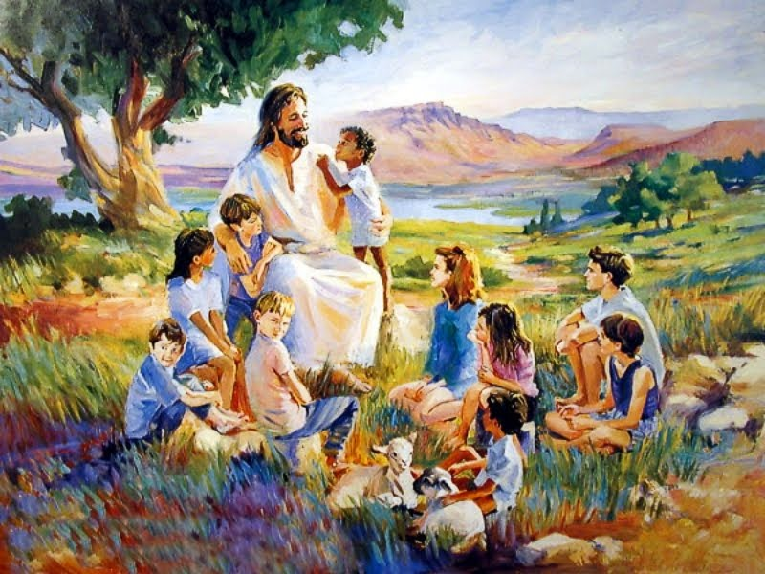
WNAC Classes October 4
5:00 PM – Pizza
5:30 PM - Class

Slide 4
Tonight’s Lesson:
How do you defend that there is God to an atheist?
Next Week’s Lesson:
How do you defend that Jesus is God to a Jehovah’s Witness?

Slide 5
Psalm 19:1
P: The heavens declare the glory of God,
C: and the sky above proclaims his handiwork.

Slide 6
Psalm 19:2
P: Day to day pours out speech,
C: and night to night reveals knowledge.

Slide 7
Psalm 19:3
P: There is no speech, nor are there words,
C: whose voice is not heard.

Slide 8
Psalm 19:4
P: Their measuring line goes out through all the earth and their words to the end of the world.
C: In them he has set a tent for the sun,

Slide 9
Psalm 19:5
P: which comes out like a bridegroom leaving his chamber,
C: and, like a strong man, runs its course with joy.

Slide 10
Psalm 19:6
P: Its rising is from the end of the heavens and its circuit to the end of them
C: and there is nothing hidden from its heat.

Slide 11
Psalm 19:7
P: The law of the LORD is perfect reviving the soul;
C: the testimony of the Lord is sure making wise the simple;

Slide 12
Psalm 19:8
P: The precepts of the LORD are right rejoicing the heart;
C: the commandment of the LORD is pure, enlightening the eyes;

Slide 13
Psalm 19:14
P: Let the words of my mouth and the meditation of my heart be acceptable in your sight,
C: O Lord, my rock and my redeemer.

Slide 14
Message How to Defend: God Created the World in 6 Days and then Rested on the 7th! 4th Commandment

Slide 15
Last Weeks Memory Verse: Psalm 53:1

Slide 16
Last Weeks Memory Verse: Psalm 53:1
P: The fool says in his heart, “There is no God.”

Slide 17
Last Week’s Verses: John 1:1, 15
“In the beginning was the Word, the Word was with God, and the Word was God… the Word became flesh and dwelt among us.”

Slide 18
How to Respond?
When someone say’s God Could not have Created the World in 6 Days

Slide 19
https://www.youtube.com/watch?v=tbhJTH1OAQ0

Slide 20
What does the Bible Say about Creation?
Exodus 20:11 “In six days the Lord made heaven, earth, and the sea, along with everything in them. He didn’t work on the seventh day. That’s why the Lord blessed the day he stopped his work and set this day apart as holy.

Slide 21
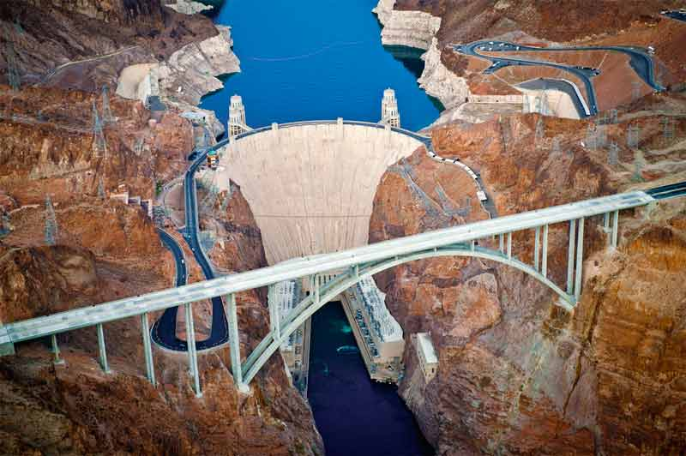
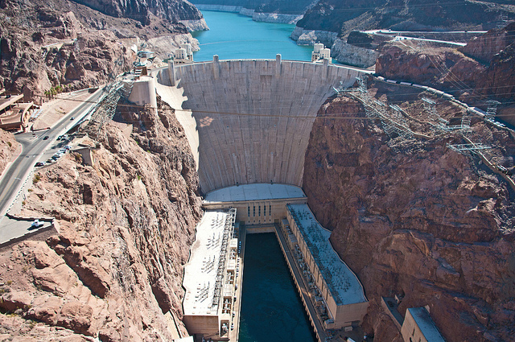
How long did it take to make Hoover Dam?

Slide 22
How long did it take to make Hoover Dam? 5 Years

Slide 23
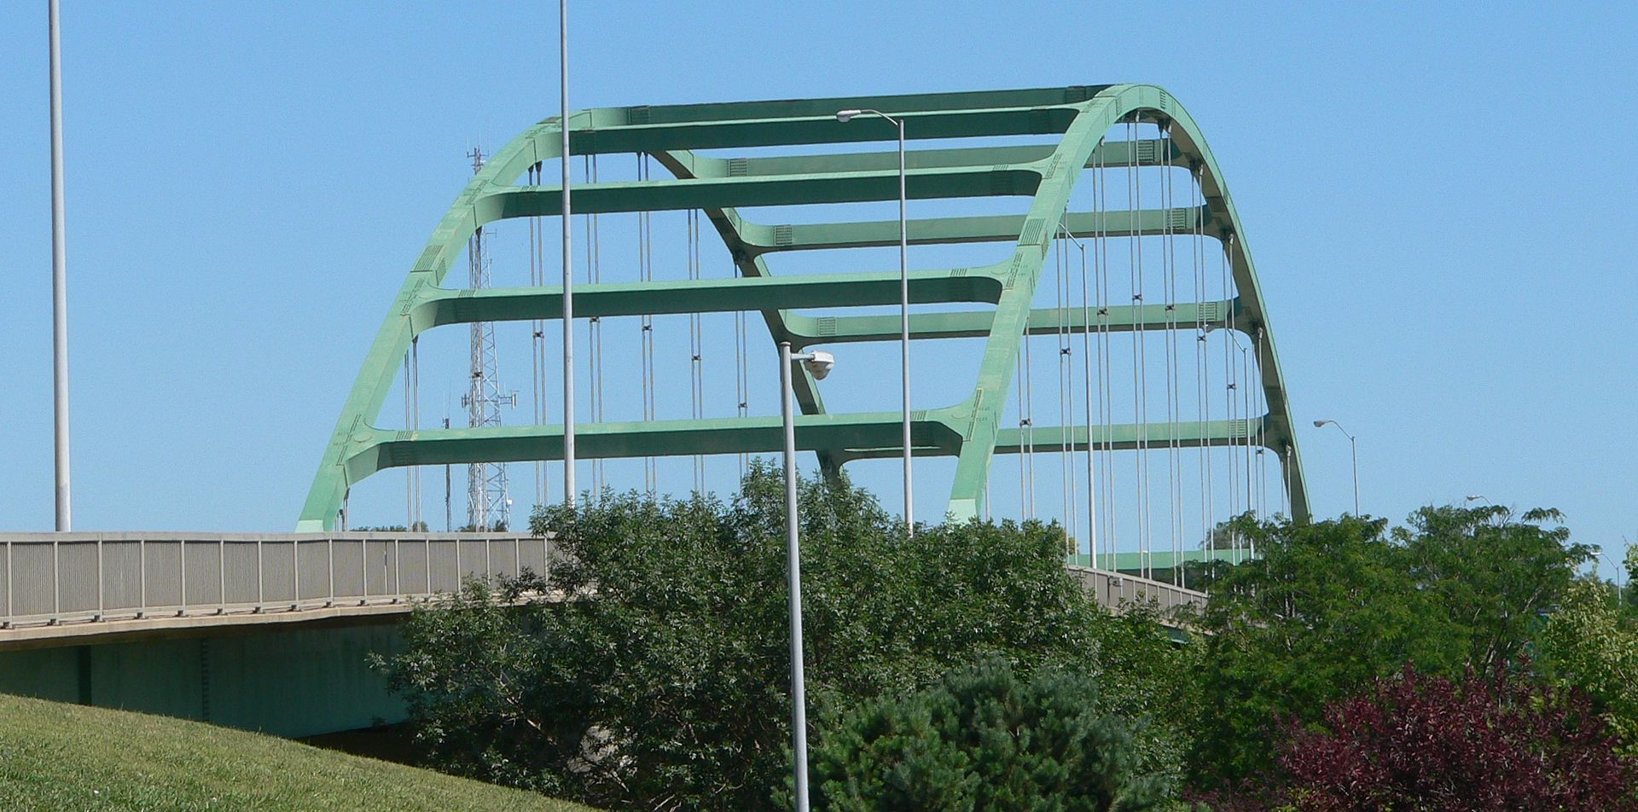
How long did it to fix Veteran’s Memorial Bridge?

Slide 24
How long did it to fix Veteran’s Memorial Bridge?
In 1982 they predicted it would take 6 days to fix a 32 inch crack.
It actually took 7 months.

Slide 25
How long did it take to make your house/apartment?

Slide 26
House Building:
The average house takes 7 months to build from start to finish.

Slide 27
How long do scientists say it took for life to evolve?
This leaves only 300 million years to go from the prebiotic soup to the RNA world and to cyanobacteria. However, 300 million years should be more than sufficient time.

Slide 28
http://impact360institute.org/videos/is-it-okay-to-question-the-bible

Slide 29
How long did it take God to create everything?
Exodus 20:11 “In six days the Lord made heaven, earth, and the sea, along with everything in them. He didn’t work on the seventh day. That’s why the Lord blessed the day he stopped his work and set this day apart as holy.

Slide 30
God is…
Omnipotent = All Powerful
Omnicient = All Knowing
Omnipresent = Present Everywhere

Slide 31
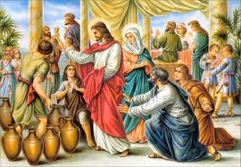
How long did it take Jesus to make wine?

Slide 32
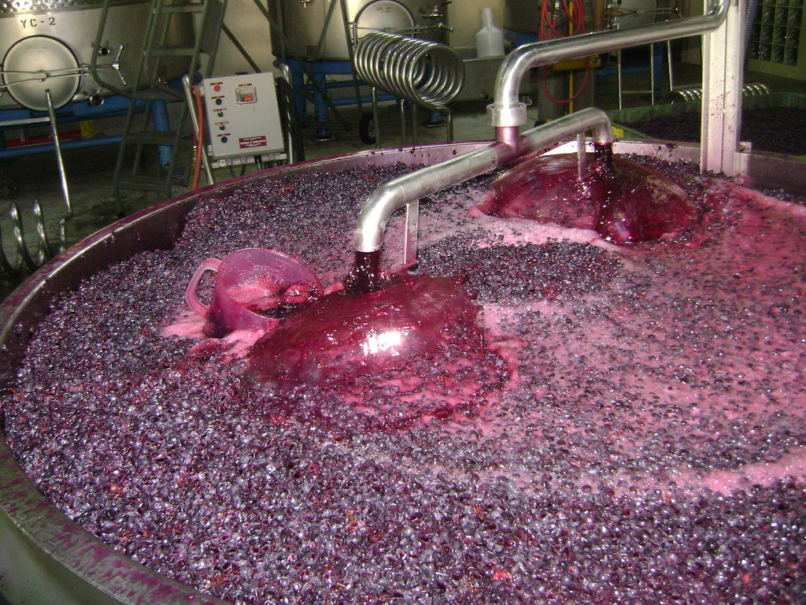
How long does it take to make good wine?

Slide 33
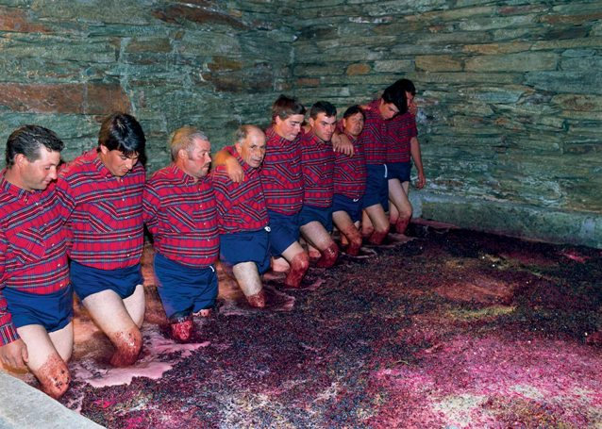
How long does it take to make good wine?

Slide 34
How long does it take to make good wine? 4-12 Months

Slide 35
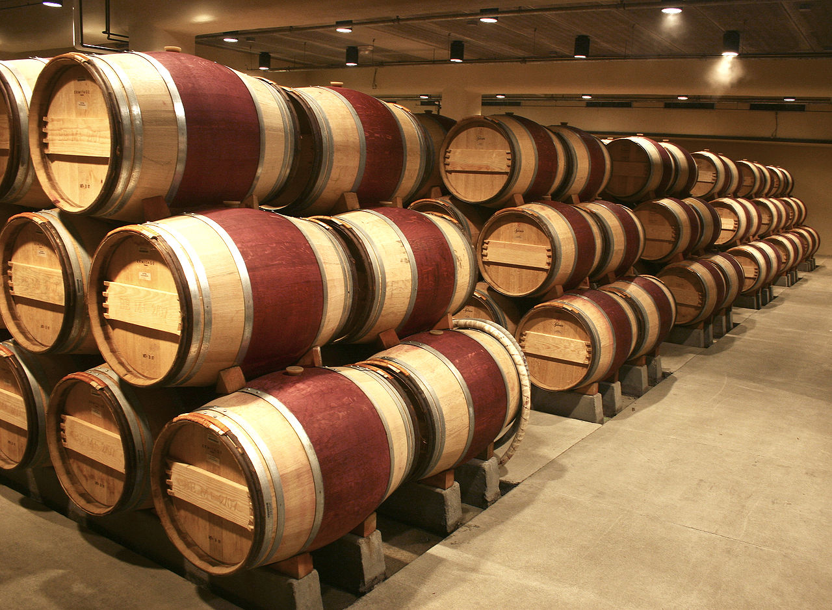
How long does it take to make good wine?
On average it takes 4-12 months to make wine!

Slide 36
How long did it take Jesus to make wine? Instantly!

Slide 38
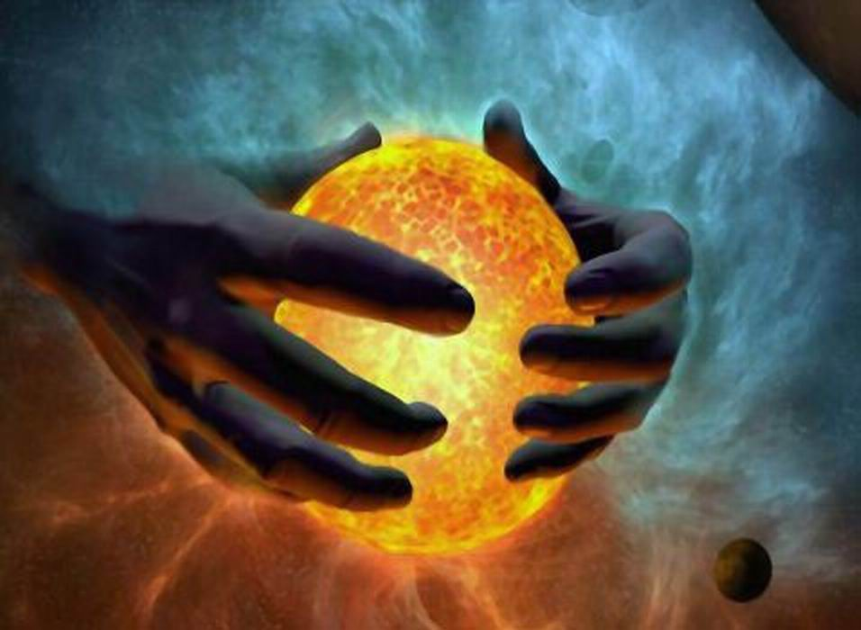
3 Arguments for a 6 Day Creation

Slide 39
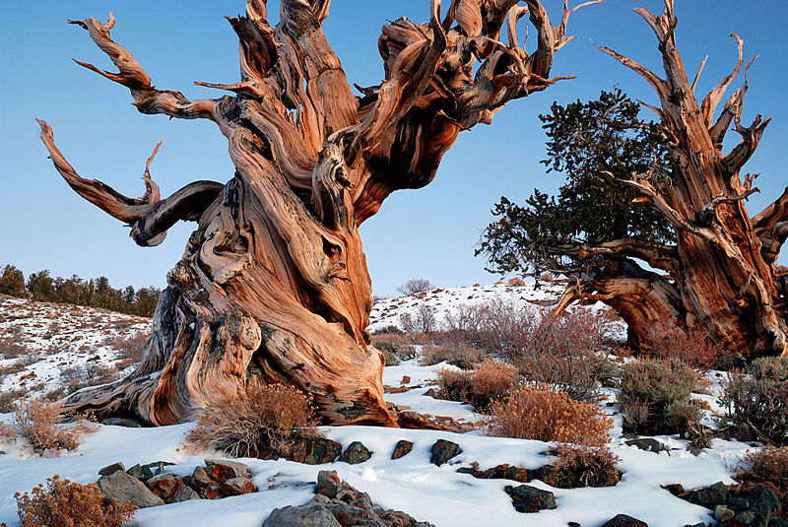
Time Clocks:
The Oldest Living Thing – The oldest living thing on earth is either an Irish Oak or a Bristlecone pine. 4,500 and 4,767 years old. This one is 4700 years old.
http://www.earthage.org/youngearthev/evidence_for_a_young_earth.htm - White Forest in California! All other trees are

Slide 40
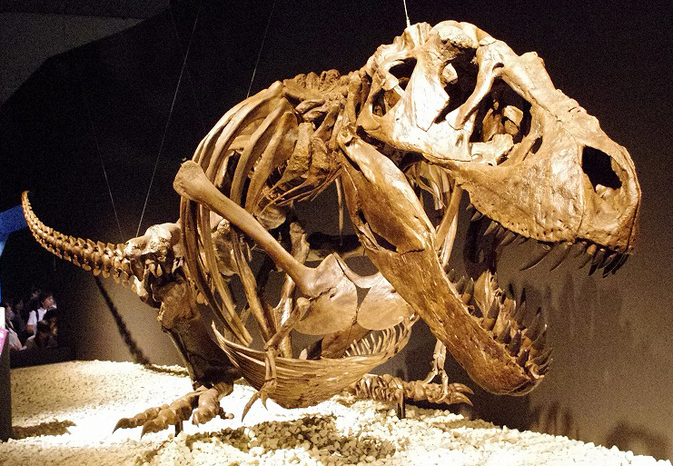
The Fossil Record Dino Blood & Ancient DNA:

Slide 41
Oldest Recorded History
The span of recorded history is roughly 5,000 years, beginning with Sumerian Cuneiform script, the oldest discovered form of coherent writing from the protoliterate period around the 30th century BC.
Ancient history - Wikipedia
https://en.wikipedia.org/wiki/Ancient_history

Slide 42
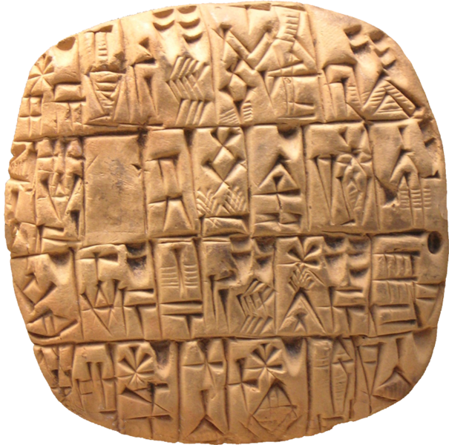

Slide 43
If God made the world in 6 days what can he do at the end of time?

Slide 44
God can make a new heaven and a new earth in less than one day!

Slide 45
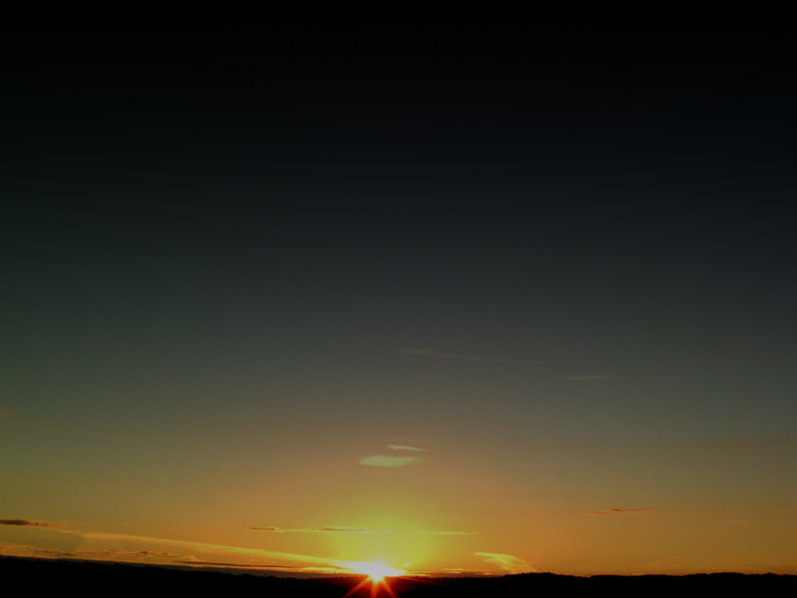
Revelation 21

Slide 46
Welcome to Calvary!

